Slide 1
Tackling Misinformation with Deep Learning
Vamshee Deepak Katta

Slide 2
What is Misinformation?

Slide 3
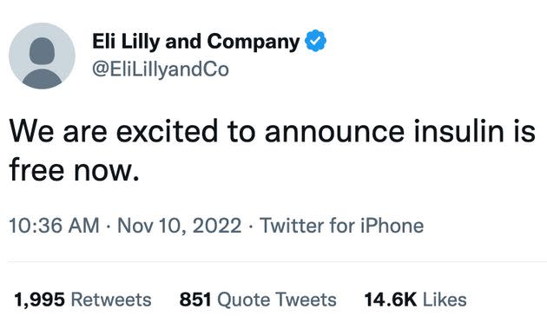

Slide 4
Technique : Self-Supervised Learning Technology: SBERT (Sentence Bert) Data: https://www.uvic.ca/ecs/ece/isot/datasets

Slide 5
How does This Project help us identify misinformation?

Slide 6
Implementation TIMELINE
1
Pretraining the model with unlabeled data on a pretext task that would be suitable for the problem that we plan on tackling
2
Fine Tuning the model after the pretext task using transfer learning to implement the pretrained model in out problem task
3
Applying loss function to the model that penalizes the model in case of inconsistency in representations
4
Implementing the pretrained model to downstream task(s)

Slide 7
Advantages of Self-supervised learning
A pretrained self-supervised model can be used in multiple tasks related to the initial training data
Scalability
Reduction in need for labeled data can lead to huge amount of data being used
Affordability
Using unlabeled data leads to reduction in manual labor and connected costs
Advancement
Self-supervised learning is a step closer to embedding human cognition in machines
Data Preparation, a lengthy process in ML lifecycle, is reduced vastly in this ML technique
Reusability
Agility

Slide 8
Conclusion
Misinformation can harm society in many ways by creating confusion and displacing belief in good sources of information.
Tackling misinformation is important to ensure true information is being consumed and false information is being rejected for positive impact on the society.
Self supervised learning helps us get a step closer to fact checking information faster and with higher accuracy.

Slide 9
References
https://www.plego.com/blog/5-deep-learning-recent-trends/
https://ai.facebook.com/blog/self-supervised-learning-the-dark-matter-of-intelligence/
https://research.aimultiple.com/self-supervised-learning/
https://perfectial.com/blog/self-supervised-learning/
https://towardsai.net/p/l/self-supervised-learning
https://analyticsindiamag.com/a-beginners-guide-to-self-supervised-classification/
https://www.fast.ai/posts/2020-01-13-self_supervised.html

Slide 10
THANK YOU
Vamshee Deepak Katta

